Slide 1
Product Classification
2024-10-30
M11202222 楊凱程

Slide 2
Introduction and Objectives
Demonstrate the functionality of the product classification system
Provide an overview of product distribution across various categories
Summarize product distribution across 1500+ categories
Facilitate hierarchical navigation from major categories down to specific products

Slide 3
Classifier Functionality Verification
The classifier can identify the top three most relevant categories for a product name, calculating the probability for each. It then selects the most likely category and assigns them as class 1, 2, and 3.
p_name | class_1 | class_2 | class_3 | category_1 | score_1 | category_2 | score_2 | category_3 | score_3
World Clean Rainbow Lisking 超細纖維拖把 105cm, 1個 | 居家生活 | 日用品 | 拖把 | 居家生活_日用品_拖把 | 0.9651933 | 文創商品_配件_人字拖/ 夾腳拖 | 0.63427836 | 男女鞋_女涼拖鞋_人字拖/ 夾腳拖 | 0.43933856
扁平肩帶調節扣 25mm, 10個, 黑鎳 | 居家生活 | 節慶、派對用品 | 彩帶、榮譽肩帶、頒獎肩帶 | 居家生活_節慶、派對用品_彩帶、榮譽肩帶、頒獎肩帶 | 0.5588459 | 戶外/旅行_戶外休閒運動_魚鉤 | 0.5402763 | 3C與筆電_相機周邊配件_轉接環 | 0.538395

Slide 4
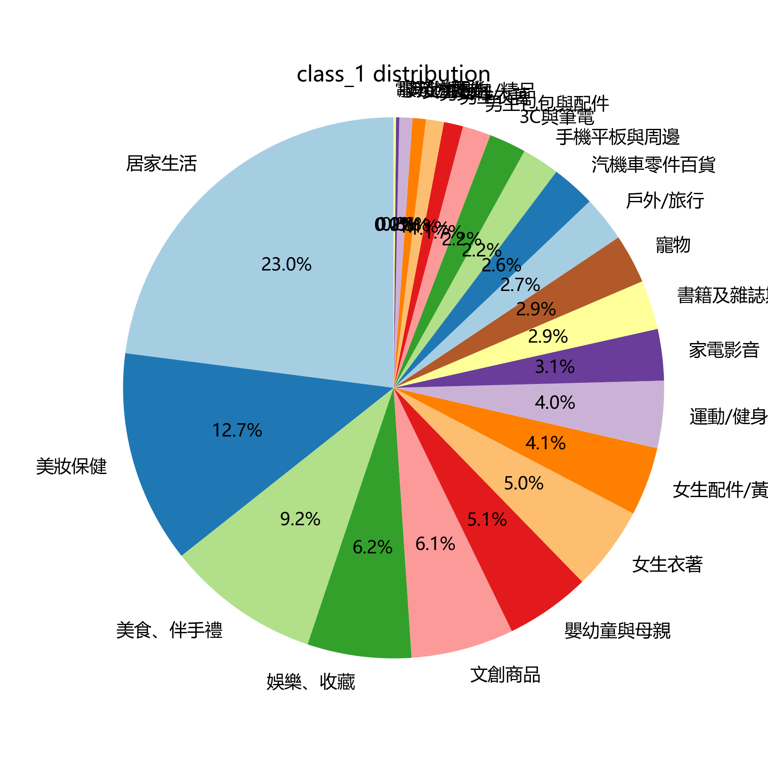
Product Set Overview (Top 20)
Top 20 Categories by Product Count:
居家生活: 6558 11. 書籍及雜誌期刊: 841
2. 美妝保健: 3631 12. 寵物: 841
3. 美食、伴手禮: 2625 13. 戶外/旅行: 776
4. 娛樂、收藏: 1774 14. 汽機車零件百貨: 750
5. 文創商品: 1755 15. 手機平板與周邊: 639
6. 嬰幼童與母親: 1451 16. 3C與筆電: 634
7. 女生衣著: 1438 17. 男生包包與配件: 481
8. 女生配件/黃金: 1171 18. 男生衣著: 328
9. 運動/健身: 1146 19. 男女鞋: 307
10. 家電影音: 878 20. 女生包包/精品: 227

Slide 5
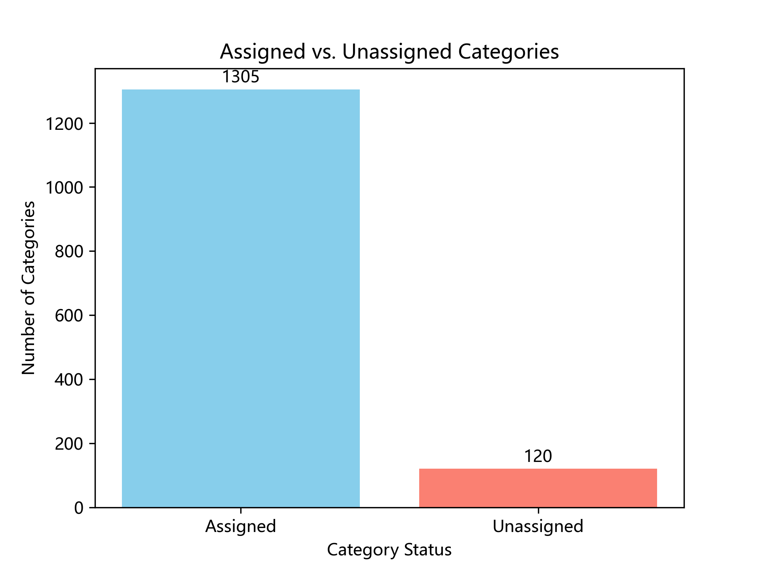
Distribution of Categories: Assigned vs. Unassigned Products

Slide 6
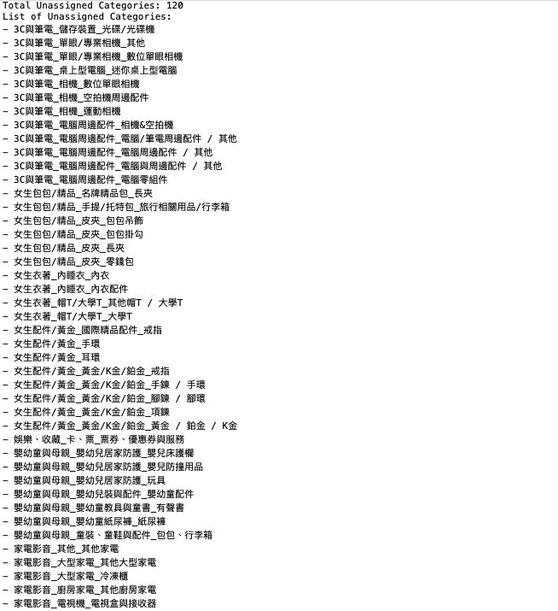
Unassigned Categories
Total Unassigned Categories: 120
Save as “unassigned_categories.txt”

Slide 7
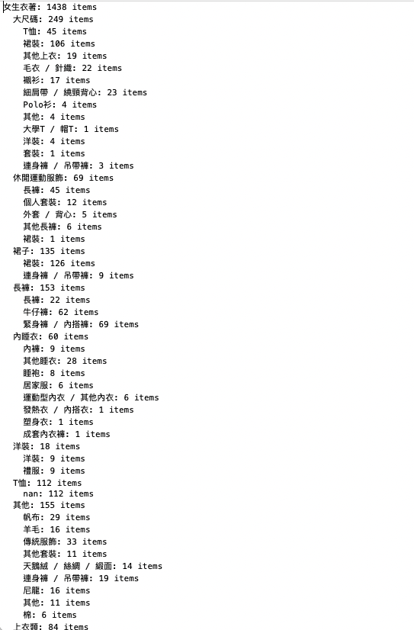
Category Hierarchy
Save as “category_hierarchy_counts.txt”
My hierarchy is displayed in three levels—major, middle, and minor categories—each accompanied by their respective counts.

Slide 8
Thanks

